Slide 1
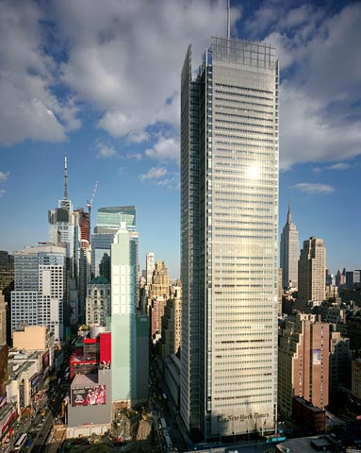
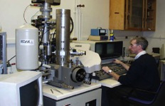
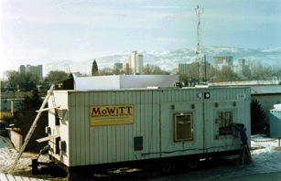
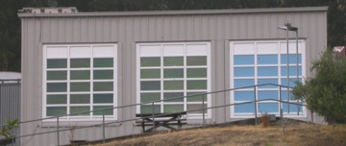
  LBNL and NTNU/SINTEF
The Future of Building Energy Efficiency
Progress via Global Collaboration
Stephen Selkowitz
Senior Advisor,
Building Technology and Urban Systems Department
  Environmental Energy Technologies Division
  Lawrence Berkeley National Laboratory
  seselkowitz@lbl.gov
10/25/2011

Slide 2
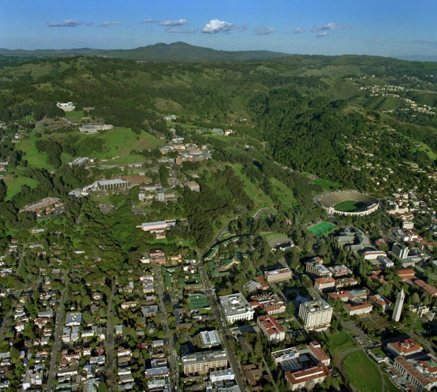
4000 Staff; $700M/yr Budget
Energy Efficient Buildings:
Established 1975, ~250+ staff
Materials, Technologies
Building Systems
Facades
Lighting, Daylighting
HVAC
Electrical loads
Indoor Environmental Quality
Hi Tech Buildings
Data Centers, Labs
Field Performance
Distributed Energy Systems
Demand Response
Electric Grid Reliability
Simulation tools
Benchmarking and Rating
Energy standards
Energy policy w/ Renewables
International Studies
LBNL: Basic sciences—advanced materials, computing, ….
UC Berkeley- Architecture, Engineering, Business,….
UC System- multi-campus collaborations….
Notes:
2

Slide 3
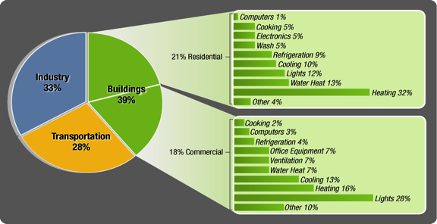
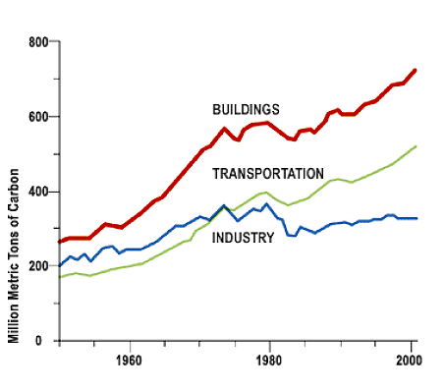
U.S. Building End Use Energy Consumption
Buildings consume 40% of total U.S. energy
  71% of electricity
  54% of natural gas
No Single End Use Dominates
Building sector has:
Largest Energy Use!
Fastest growth rate!

Slide 4
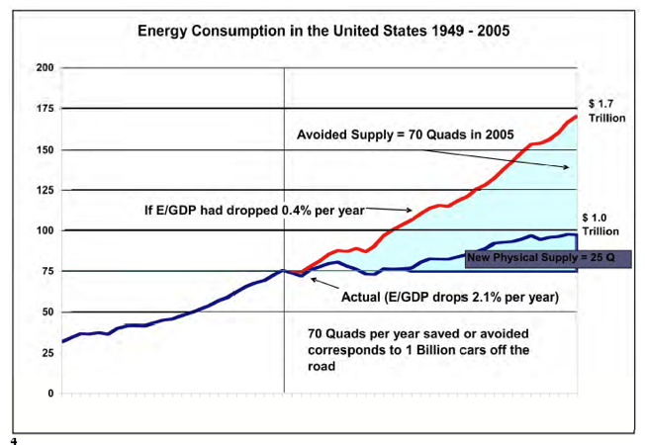
History and Future Needs
Good News/Bad News
Annual Energy Outlook Forecast ~+30%
2008
1990
-50%
-80%
We’ve reduced the rate of growth but to meet to meet the various 2030- 2050 Energy and Carbon goals we need dramatic reductions, never before achieved
1973
2005
2020
2030
2050
Caution: Energy vs GHG goals

Slide 5
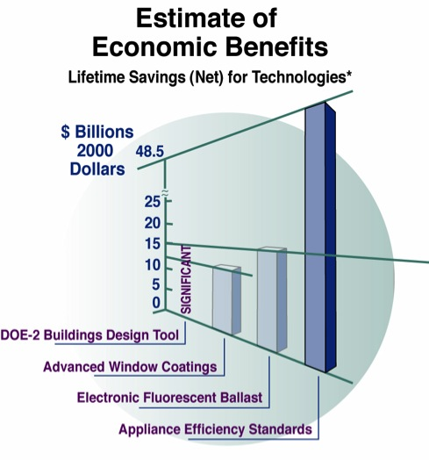

Prior Impacts of Efficiency R&D
From National Academy of Sciences Report (2001)
NAS estimate of economic benefits of EE R&D assigns $23 of $30 billion in savings to building technologies.
ROI => 1000/1 for successful investments;
Overall Portfolio shows net gain with small number of big winners.
Additional $48 billion in savings from energy efficiency standards for 9 residential products

Slide 6
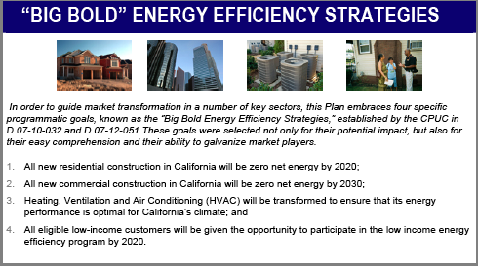
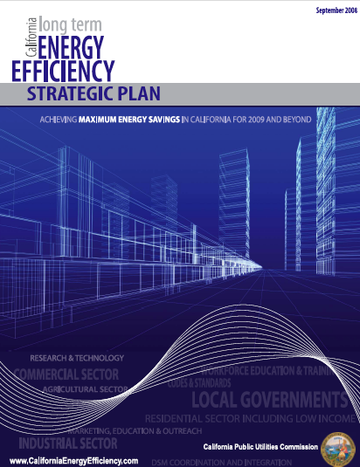
California:
All new residential construction will be zero net energy by 2025
All new commercial construction will be zero net energy by 2030

Slide 7
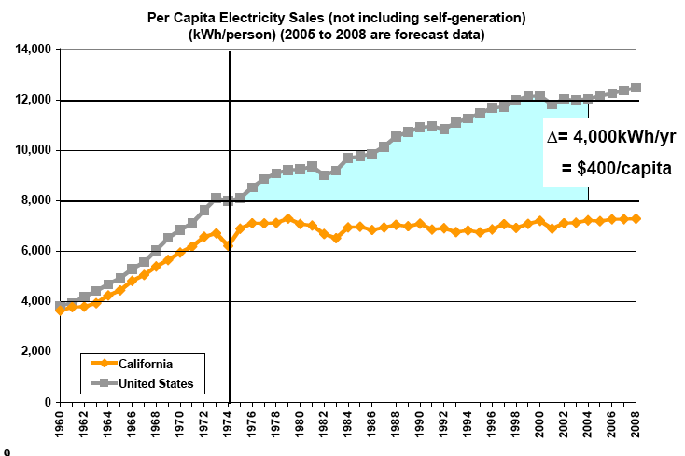
California Success to Date: Per Capita Electricity Sales
US
CA
“Consistent” 40 yr message
Technology, Policy, (Mandatory/voluntary)
Political Leadership
Funding to implement programs
Novel utility programs: rates, decoupling
Talent and Expertise
Innovation: “Silicon Valley”
Note: per capita is flat is but Total still increases with Population

Slide 8
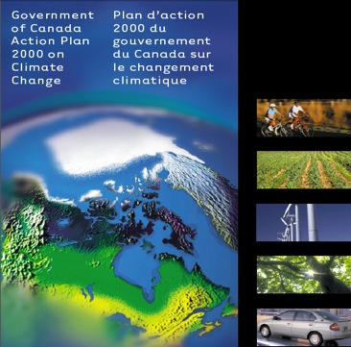
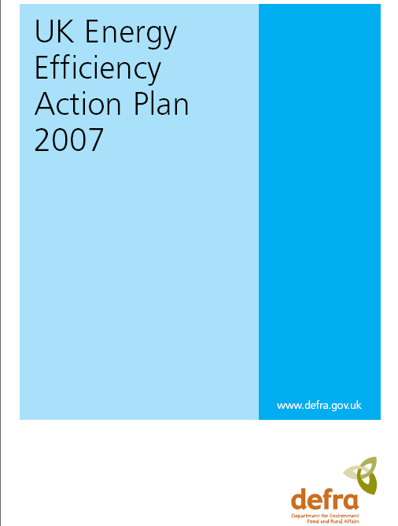
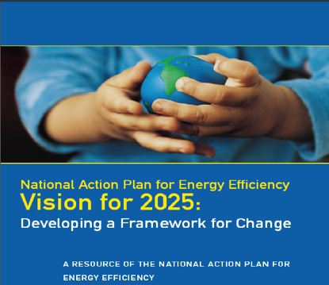
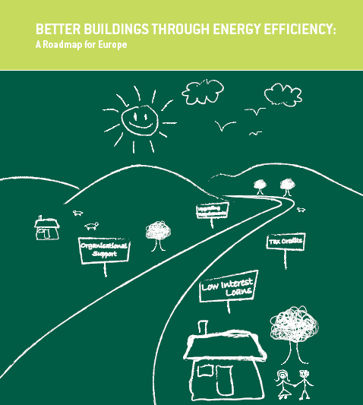
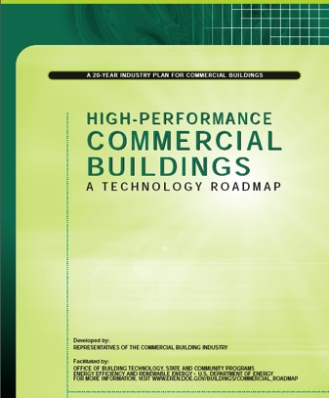
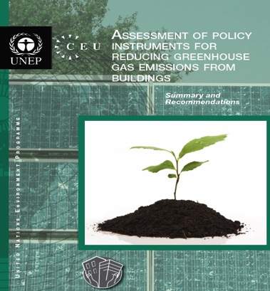

Slide 9
Research Center on Zero Emission Buildings - ZEB
In 2009, the Research Council of Norway assigned The Faculty of Architecture and Fine Art at NTNU to host the Research Centre on Zero Emission Buildings (ZEB), one of eight new national Centres for Environment-friendly Energy Research (FME).
Centre Objectives:
  development of technologies for environmentally friendly energy,
  raise the level of Norwegian expertise,
  generate new industrial activity and new jobs.
The FME-Centre ZEB will develop competitive products and solutions for existing and new buildings that will lead to market penetration of zero emission buildings
The ZEB Centre consortium encompasses the following partners:
  The Norwegian University of Science and Technology, NTNU (the host)
  SINTEF (research partner).
  8 Industry Partners
  International Advisory Committee

Slide 10
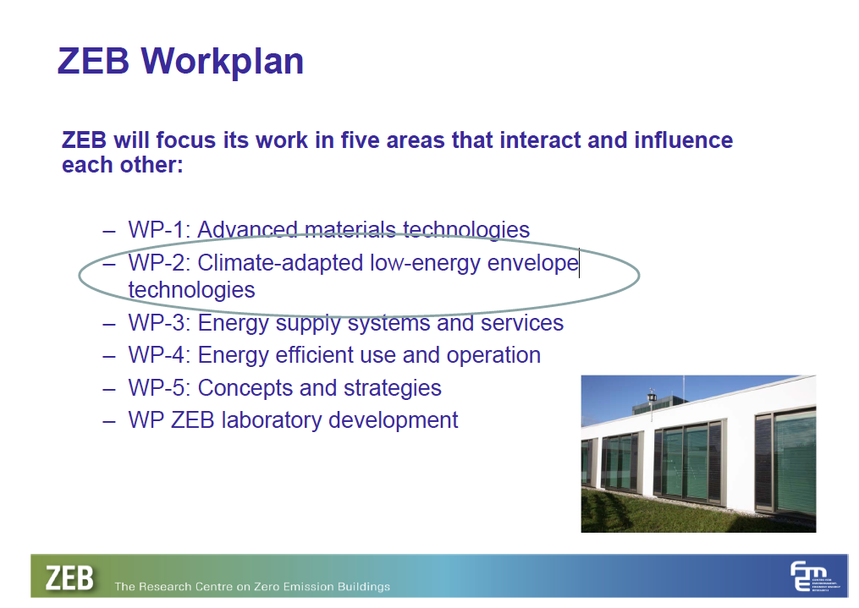
Zero Emissions Buildings Research Centre
Arild Gustavsen, Professor, Ph.D.
Research Centre on Zero Emission Buildings/
Department of Architectural Design, History and Technology,
Norwegian University of Science and Technology (NTNU)

Slide 11
Building Innovation “Game Changers”
MATERIALS AND SYSTEMS
Smart Glass/Dynamic solar control
High R Windows, Insulation
Thermal Storage- Envelope, structural
200 lumen/watt lighting
Daylight integration
Dimmable, Addressable Lighting Controls
Task Conditioning HVAC
Climate Integrated HVAC
HVAC vs comfort and IEQ
Miscellaneous Electrical Loads
Demand Response
Controls infrastructure- sensors, networks
Building- and Grid- Smart electronics
Electrical Storage
LIFE-CYCLE OPERATIONS
Building Life Cycle Perspective
Benchmarks and Metrics
Building Information Models (BIM)
Integrated Design Process and Tools
Building Operating Controls/Platform
Building Performance Dashboards
Understanding Occupants/Behavior
Facility Operations

Slide 12
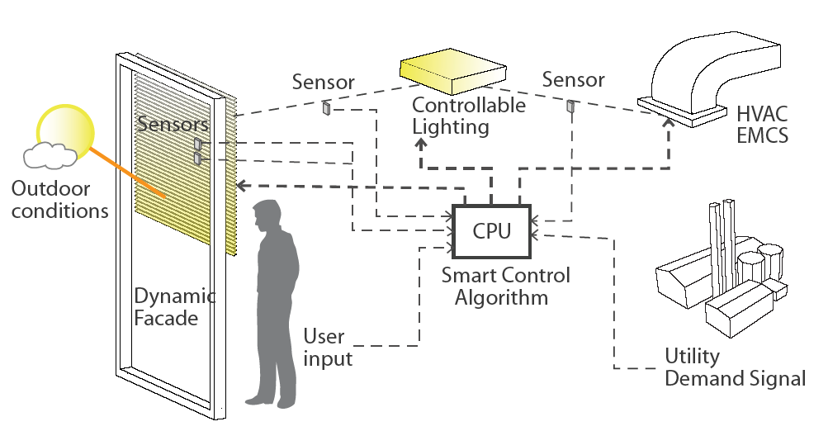
Advanced Facades and Daylighting
Program Goals:
Net Zero Energy Balance for New and Retrofit
Enhanced View and Thermal Comfort
Reliable, cost effective operations
Tools to design, optimize, specify, control
Adoption/diffusion throughout industry
Application:
All climates
All Building types
New-Replacement-Retrofit
Program Activities:
Simulation
Optimization
Lab test
Field Test
Demonstrations
Standards
Advanced Technologies:
Sensors;
Controls;
Hi R windows,
Cool coatings;
Switchable coatings;
Automated Shading;
Daylight-redirecting
Operable windows,
Partners
Manufacturers
Owners
Architects
Engineers
Specifiers
Code officials
Contractors
Utilities
Business Case
Manufacturing
Installation
Commissioning
Reliability
Cost
Human Factors:
Thermal comfort
Visual comfort
Satisfaction
Performance
Decision Tools
Books, Guides
Websites
Simulation Tools
Testbeds

Slide 13
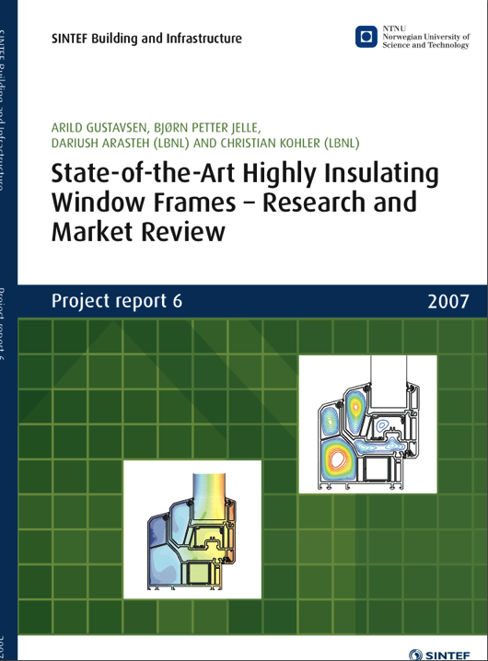
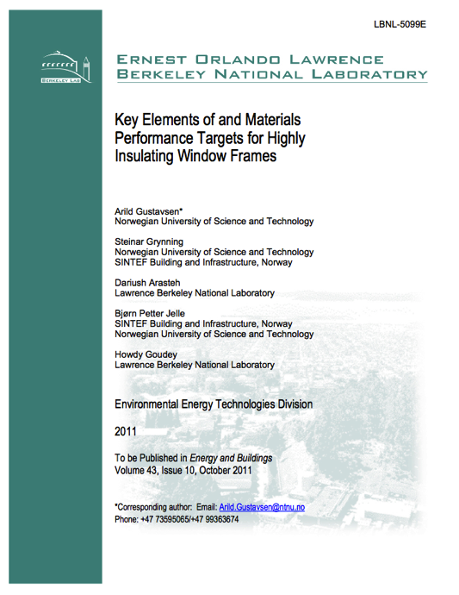

Slide 14
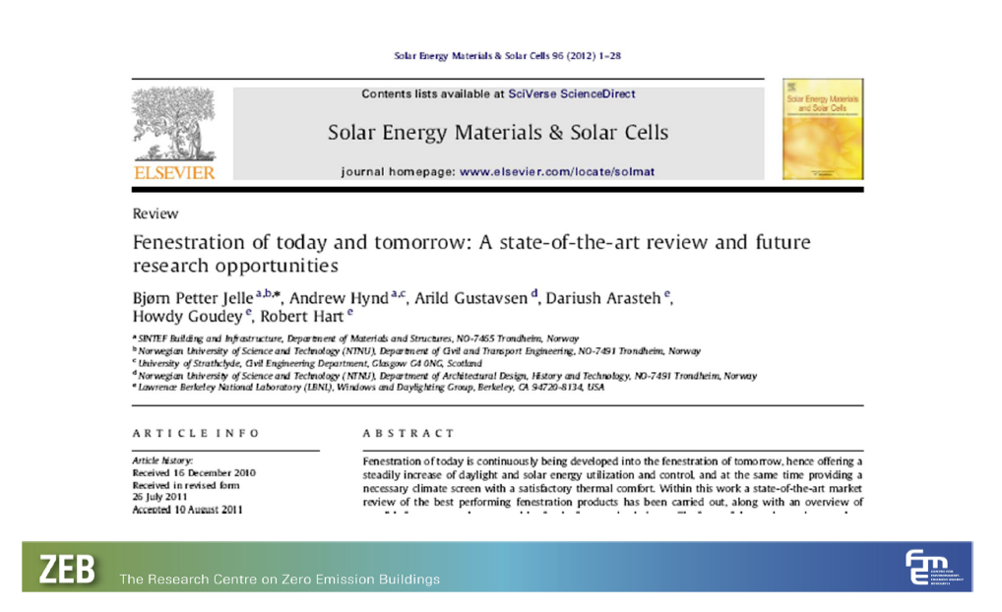
Joint Papers- Future Directions

Slide 15
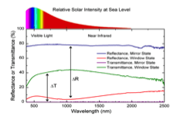
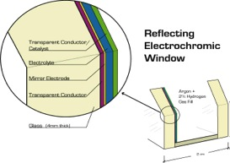
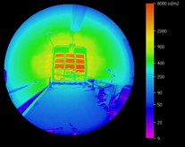
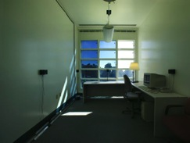
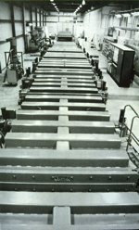
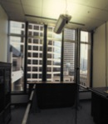
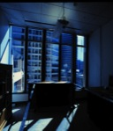
Integrated Technology R&D Program
Invent
Integrated
Window
Characterize
Coating
Performance
Mg₂Ni
Invent New
Materials
Assess
Human
Factors
Assess
Savings
Invent
Innovative
Manufacturing
Process
Invent/Test
Integrated
Systems
Notes:
How do we approach R&D on these topics at LBNL- in order to have market impacts need to integrate R&D with building physics, business, manufatcuring process control etc as the work done- not after the fact. LBNL has capabilities across this spectrum of work

Slide 16

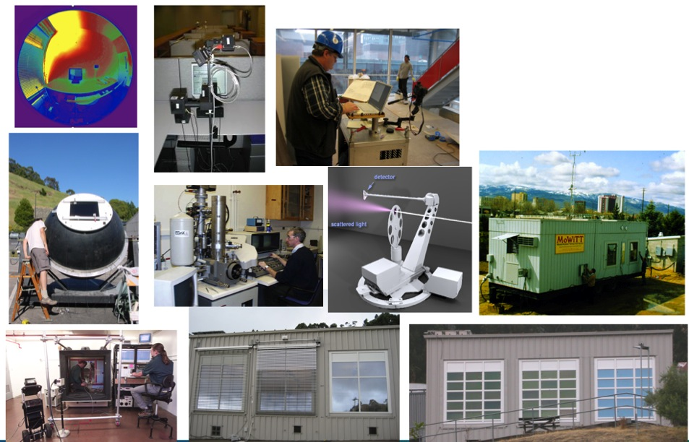
Glazing/Shading/Daylighting
Measurement and Validation
Façade/daylighting test facility
Integrated Systems testbeds
Mobile Thermal Test Facility
IR Thermography chamber
Large integrating sphere
Optics laboratory
Scanning Goniophotometer
HDR Imaging
Field Data Collection systems
Commissioning systems
Virtual Building Controls Testbed
Daylighting controls laboratory

Slide 17
(Day)Lighting Control Elements
ballast controller
ballast
lamp
sensor
Electric
Light
S
+
elec
S
View
daylt
Task
Illum
Daylight
Ambient
Illum

Slide 18
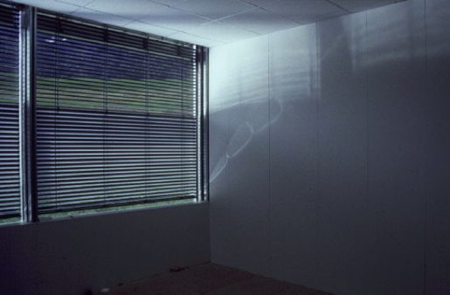
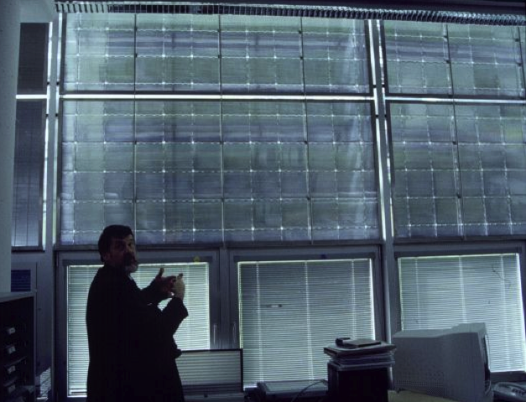
Emerging Daylighting Technology
Øyvind Aschehoug,
Professor emeritus
Dept. of Architectural Design, History and Technology
Faculty of Architecture and Fine Art
Norwegian University of Science and Technology, NTNU
Sabbaticals at LBNL: 1984, 1998

Slide 19
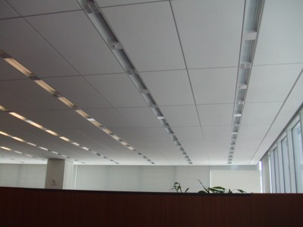
Intelligent Lighting and Shade Control
New York Times HQ
Dimmable lighting
  Addressable
  Affordable (1/3 original cost estimate)
  Multifunctional
Automated Shading
  Cooling load control
  Glare control
New York Times office with dimmable lights and automated shading
Occupied 2007
Notes:
Owner of NYTimes came to us for help; building was designed but they wanted integrated controls to manage cooling load at windows, control glare and provide daylighting energy benefits- we convinced them it could be done but needed field tests….

Slide 20
Good Lighting Controls (Daylight Dimming) Work
Data from advanced lighting controls demonstration
in Emeryville, CA (1990) !!!
Energy Use before retrofit:
After retrofit:
South zone:
North zone:
40-60%
Savings
40-80%
Savings
Dimming is 3% of lighting sales
Notes:
Close by defining a few challenges
DL dimming works- saves energy ( people claim it wont, cant)
But not just flooding a room with DL- shading!

Slide 21
System integration: Cost tradeoffs
Office Eq.
$
Heating
$
Peak
Cooling
Chiller
Cooling
Load
Size
Onsite
Power
Generation
Energy,
Peak
Lighting
Lighting
Design
Electric
Central
Power
Generation
Strategy
Demand,
Load
$
$
Shape
Initial Cost
$
Annual Cost
$
$

Slide 22
Exploring Intelligent Control Systems
Task
Dynamic
Requirements
Window
(active control of daylight, glare, solar gain)
H
V
A
C
User
Preferences
Smart
Controllers
Lighting
Interior Conditions
Systems
(with dimming ballasts, sensors)
Weather
Conditions
Building
Load Shedding/
Energy Information
System
Performance
Demand Limiting
(cost, comfort,
Signal
operations)
Sensors, meters,…
Notes:
Conceptual diagram for getting the façade and lighting to work together. How to do the right thing?
Could be a person as well as a sensor/computer… but people have other work to do
we are fans of automation but will it work at scale
do we need all this complex, expensive hardware, software….which can be very expensive- how do we assess cost?
IT DEPENDS

Slide 23
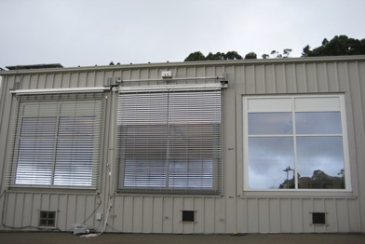
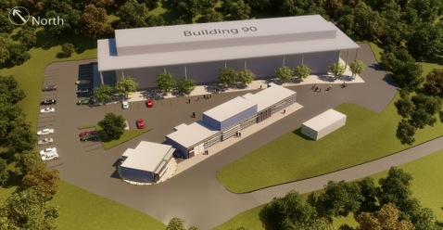
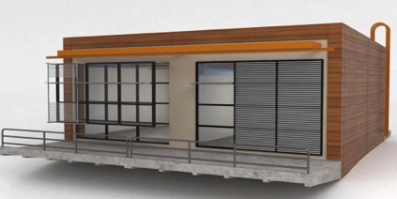
Accurate, Objective Performance Data
Facility for Low Energy EXperiments in Buildings
FLEXLAB
  Multiple comparative experiments
  Interface with public and private test sites
  Link and share experimental data sources
  Objective, “third party” data
  What works? How well? Why? Why Not?
  Integrated building systems performance
  Occupant behavior and energy impacts
  Validation of design tools
Design: 2011
Construction: 2012
Operations: 2013

Slide 24
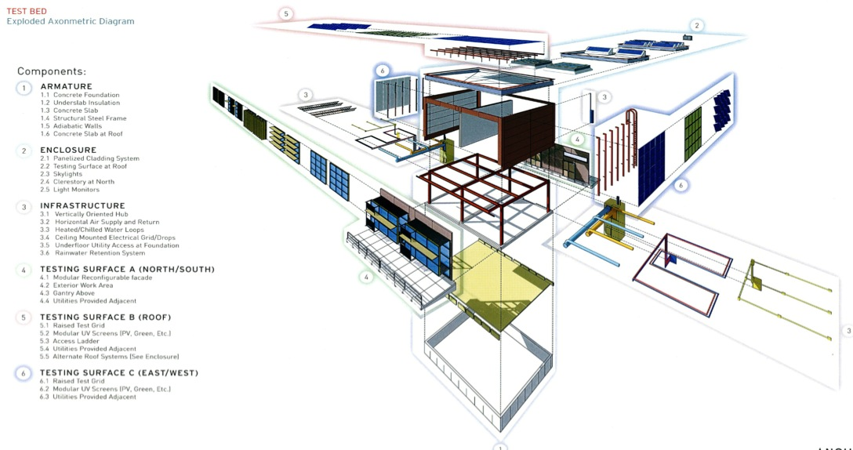
FLEXLAB: Centerpiece for U.S. and Global Collaboration, e.g. IEA Annex 58

Slide 25
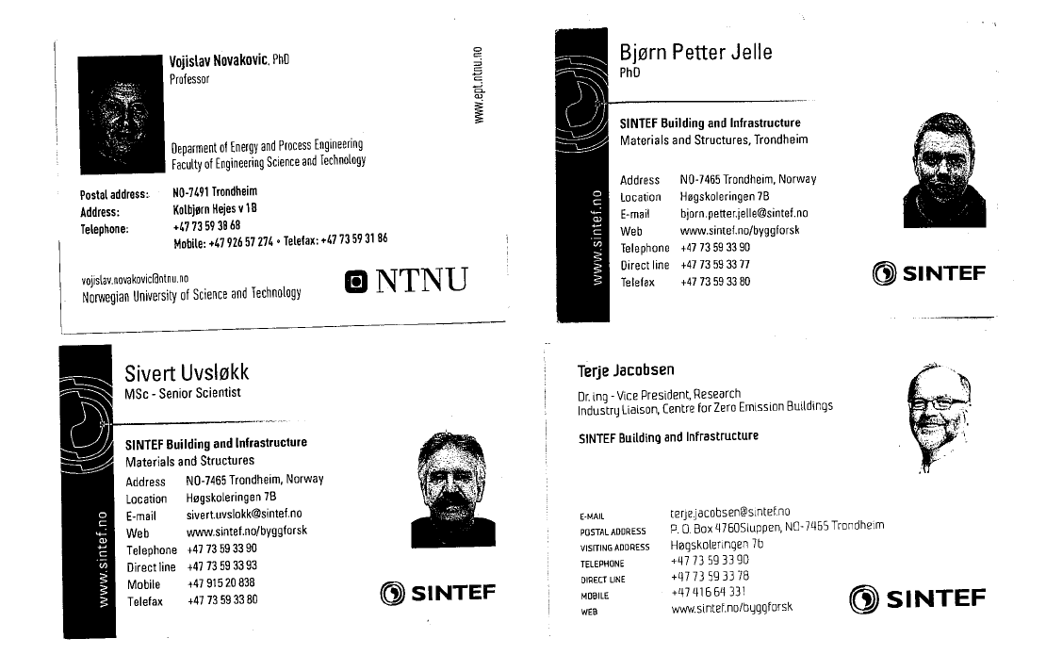

NTNU/SINTEF Collaborators
New Facilities Design

Slide 26

Accelerating Progress Towards High Performance Building Systems with Global Collaboration
Innovation → Implementation → Impact
Add Value,
Reduce Operating Costs
Reduce Energy, Greenhouse Gas Emissions
Improve
Occupant Comfort,
Satisfaction and Performance
Planet
Building Owner
Occupant

